Slide 1
Employee Data Analysis using Excel
STUDENT NAME: ELAKIYA T V
REGISTER NO:322200098
DEPARTMENT:B.Com Honours
COLLEGE: Shri Shankarlal Sundarbai Shasun Jain College for Women

Slide 2
PROJECT TITLE
Employee Performance Analysis using Excel

Slide 3


AGENDA
Problem Statement
Project Overview
End Users
Our Solution and Proposition
Dataset Description
Modelling Approach
Results and Discussion
Conclusion
3/21/2024 Annual Review

Slide 4

PROBLEM STATEMENT Measurement Challenges: Many firms encounter difficulties developing trustworthy metrics that precisely measure employee performance. Conventional methods of performance evaluation frequently fall short of fully appreciating an employee’s contributions, resulting in evaluations that are prejudiced or incomplete. Impact of Performance Factors: It’s important to comprehend how a variety of elements, including leadership, work environment, motivation, and job satisfaction, affect employees’ performance. Having this knowledge is essential to creating performance-enhancing tactics. Conformity to Organizational Objectives: A major difficulty is making sure that employee performance measurements line up with organizational goals and objectives. Inefficiencies and a decrease in the efficacy of reaching strategic goals can result from misalignment.

Slide 5

PROJECT OVERVIEW
The purpose of the system’s streamlined approaches to data collecting, processing, and visualization is to increase the efficacy of performance data management. It consists of the following components:
Compiling Information: Compile data on key performance indicators (KPIs) such as completed tasks, attendance records, revenue from sales, efficiency of operations, and management evaluations.
Data entry and formulas: To ensure structured storage, arrange the data in Excel tables.To compute performance ratings, efficiency measures, and other relevant indicators, use the appropriate formulas. Correctly rephrase this while keeping the room for subheadings.
Formatting on Condition: Use conditional formatting tackles to find and emphasize performance anomalies, such as underperformers and top performers.
Devices for Analyzing Data: Employ Excel’s analytical characteristics, including PivotTables, charts, and trend lines, to gather and present performance data for different categories, such departments, teams, and time intervals.

Slide 6




WHO ARE THE END USERS? Managers Employees Stakeholder Executives

Slide 7

OUR SOLUTION AND ITS VALUE PROPOSITION
It enables the business to carefully track, assess, and present employee performance in light of key factors:
Automated gathering of data and computation: By using this technology, the company can stay out of trouble.
Alerts: You may identify regions of underperformance as well as top achievers by using conditional formatting.
Deep reporting:It helps HR and management make informed decisions and avoid misunderstandings.
Customized dashboards: These help HR and management in relying comparisons and illustrating performance trends.

Slide 8
Dataset Description
The dataset used in this employee performance analysis contains various performance related attributes, which includes,
Employee ID
First name
Last name
Business unit
Employee status
Employee type
Employee classification type
Performance score
Current employee rating

Slide 9

THE "WOW" IN OUR SOLUTION
=IFS(Z2>=5,"VERY HIGH",Z2>=4,"HIGH",Z2>=3,"MED","TRUE","LOW")
3/21/2024 Annual Review
9

Slide 10
MODELLING
DATA COLLECTION:
USING THE DASH BOARD, THE DATA HAS BEEN GATHERED 2) FEATURE COLLECTION:
THE TEN FEATURES THAT ARE LISTED WERE USED FOR THE DATA ANALYSES. 3) DATA CLEANING :
DETERMINING WHICH VALUES ARE ABSENT.
THOSE MISSING VALUES FILTERED 4) PERFORMANCE LEVEL CALCULATION:
USED THE FORMULA TO FIND THE PERFORMANCE LEVEL BY TAKEN INTO ACCOUNT OF THE CURRENT EMPLOYEE RATING. 5) PIVOT LEVEL SUMMARY:
DIVIDING CERTAIN ANXIETIES TO ROWS, COLUMNS, HEADING, AND SO Upon. 6) VISUALIZATION:
CREATED THE GRAPH FOR PREISE VISUALIZATION AFTER FINISHING WITH PIVOTTABLEE.
10

Slide 11
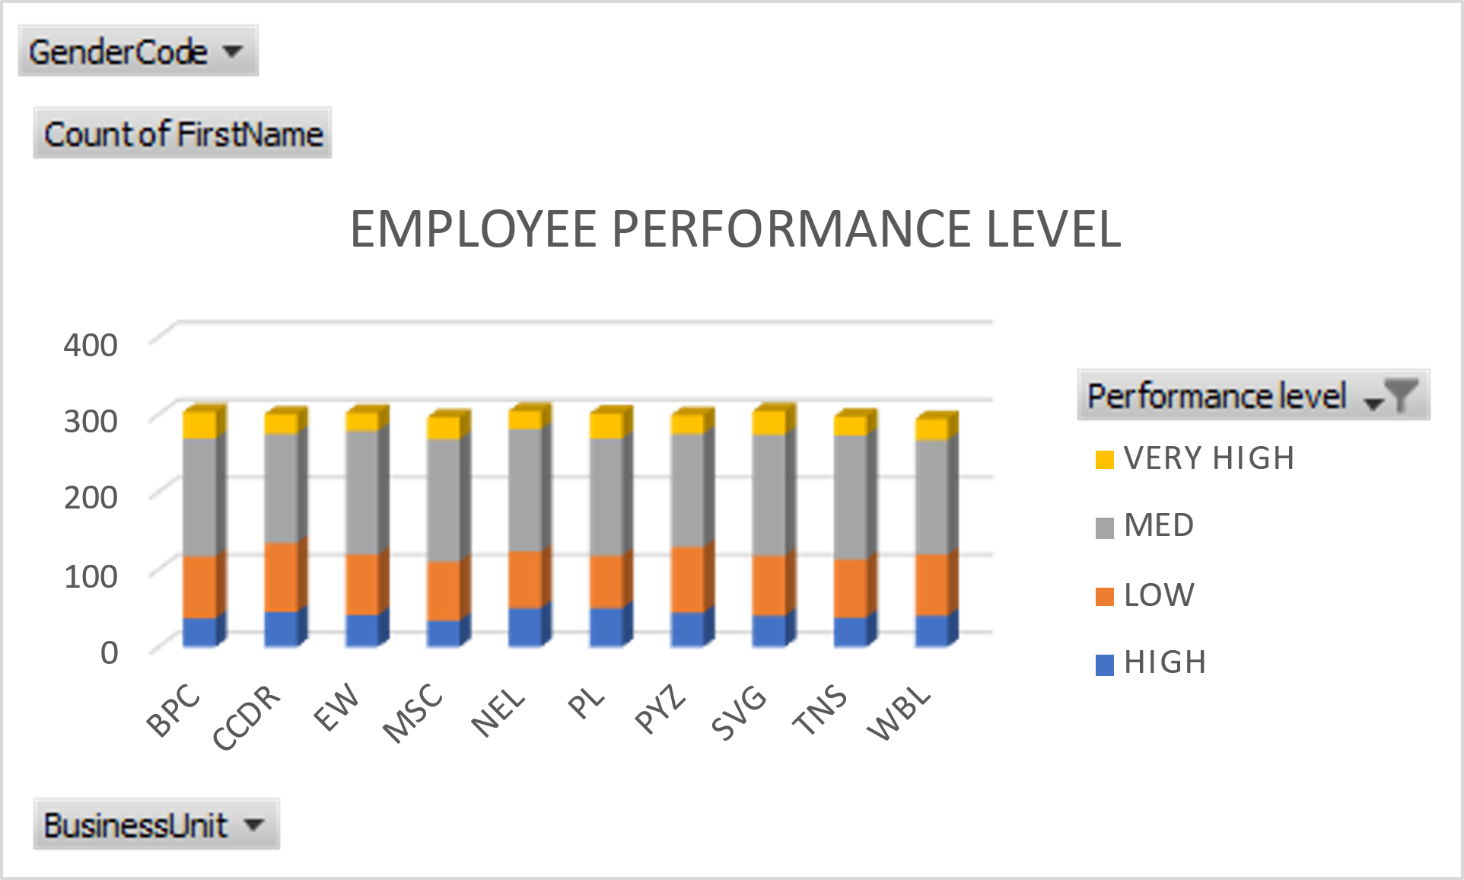
RESULTS
11

Slide 12
Conclusion
With the help of this system, firms may maximize employee performance management in a flexible, effective, and efficient manner. Improving performance data’s usability and accessibility encourages continuous increases in worker productivity as well as the growth of a motivated, goal-oriented team.
Using an Excel-based employee performance analysis system is a smart and practical move for businesses looking to improve labour management. It offers quick insights and facilitates the monitoring of critical performance metrics, enabling managers to make fact-based choices. Businesses of different types may use the system because of it’s adaptability, affordability, and scalability.

